Slide 1
Actor based concurrency with Elixir
Get ready for soft real-time systems

Slide 2

By Adrian Magdas
Co-Founder & Lead Developer @ Crafting Software Innovation
adrian@craftingsoftware.com

Slide 3
Agenda
Concurrency vs. parallelism
Why Functional Programming
Actor model concurrency
Why Elixir & Erlang
Short introduction to Elixir
Elixir agents
OTP patterns for handling agents: GenServer & Supervisor

Slide 4
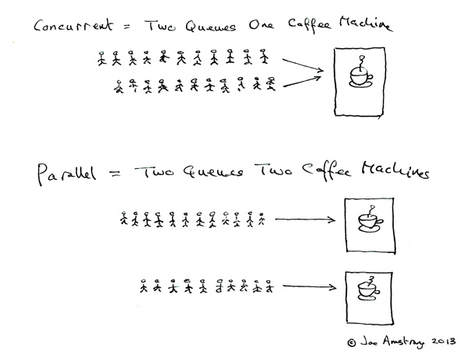
Concurrency vs. parallelism

Slide 5
Why Functional Programming
Handling concurrency in imperative languages with shared mutable state is hard to get right, a lot of well known issues: race conditions, deadlocks
FP avoids the problems associated with shared mutable state by forcing immutability
Usual properties for a functional language: functions as first class citizens, referential transparency, immutability, persistent data structures, pattern matching, pure functions, data separated from transformations

Slide 6
Actor model concurrency
The actor model in computer science is a mathematical model of concurrent computation that treats "actors" as the universal primitives of concurrent computation. In response to a message that it receives, an actor can: make local decisions, create more actors, send more messages, and determine how to respond to the next message received. Actors may modify private state, but can only affect each other through messages (avoiding the need for any locks). (Wikipedia)

Slide 7
Why Erlang
Erlang and Elixir are impure, dynamically typed functional languages
Both run on the BEAM (Erlang VM) which has built-in concurrency, distribution and scalability, actors are part of the language itself
SMP support since 2006
Built-in fault tolerance: 99.99999% uptime
Battle tested: ~50% of all mobile comms go through Erlang boxes
Happy coincidence: the solution to telecom problems for reliability and scalability are a perfect match for the same problems the web and IOT are facing
2 million web servers vs. 1 server with 2 million connections

Slide 8
Why Elixir
Modern language with solid additions to Erlang: protocols, macros, sigils, pipe operator, great tooling
Beauty and expressiveness of Python & Ruby, power and awesomeness of Erlang
Compatible with existing Erlang infrastructure and libraries

Slide 9
Short introduction to Elixir
Let’s see some syntax and language data types to be able to understand the examples
CODE

Slide 10
Elixir agents
Agents in Elixir are regular light weight processes
In Elixir, all code runs inside processes. Processes are isolated from each other, run concurrent to one another and communicate via message passing.
Messages are sent asynchronously and stored in mailboxes
Used for keeping state or running asynchronous code
CODE

Slide 11
GenServer
A behaviour module for implementing the server of a client-server relation.
A GenServer is a process like any other Elixir process and it can be used to keep state, execute code asynchronously and so on. The advantage of using a generic server process (GenServer) implemented using this module is that it will have a standard set of interface functions and include functionality for tracing and error reporting. It will also fit into a supervision tree.

Slide 12
Supervisor
Process that supervises other processes(child processes)
Fits into a supervision tree
Multiple supervision strategies: :one_for_one, :one_for_all, :rest_for_one, :simple_one_for_one

Slide 13
Take-aways
Functional programming: functions as first class citizens, referential transparency, immutability, persistent data structures, pattern matching, pure functions, data separated from transformations
Actor based concurrency: light weight processes, no shared state between actors, process linking and monitoring, all the communication happens by sending messages
OTP: patterns for handling process creation, supervision strategies and fault-tolerance support
There are no silver bullets :)

Slide 14
Thank you
Develop with passion!

Slide 15
Resources
https://pragprog.com/book/elixir/programming-elixir
http://elixir-lang.org/
http://elixirschool.com/
http://learnyousomeerlang.com/what-is-otp
http://learnyousomeerlang.com/the-hitchhikers-guide-to-concurrency
https://joearms.github.io/2013/04/05/concurrent-and-parallel-programming.html

